Slide 1

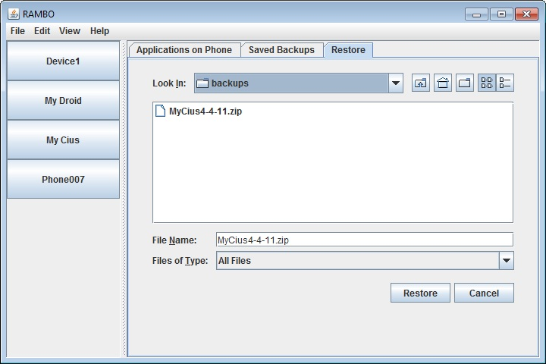
Project Title in Here
Author 1, Author 2, Author 3, Author 4
Goal:
Approach:

